Slide 1
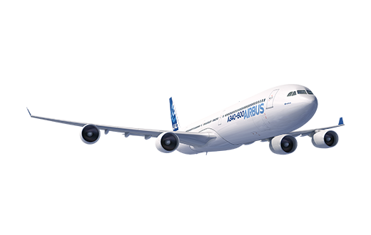
Aircraft Fuel Leaks
Detection
Airbus Case Study

Slide 2
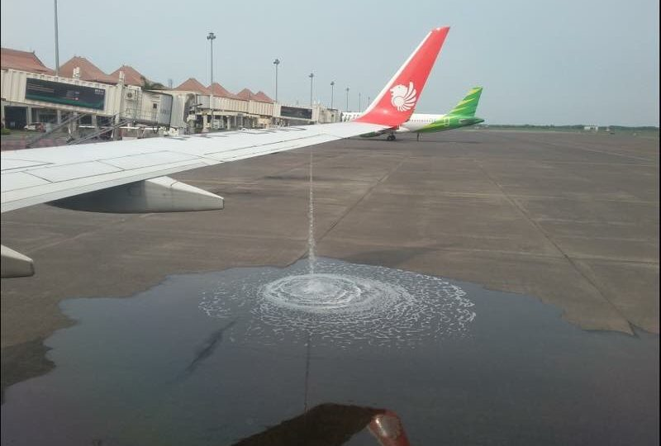
Aircraft Fuel Leaks Detection
Context:
The appearance of fuel leaks in an aircraft is detected once the aircraft has landed, when maintenance operators carry out a visual inspection and observe fuel falling from the tanks.

Slide 3
Aircraft Fuel Leaks Detection
Problem:
Automatic detection of fuel leaks done by the aircraft is not accurate due to fuel volume measurement error in the tanks.
Typical causes of failures:
Tank sealant degradation.
Fuel tank structural damage.
Consequences:
Aircraft unavailability (“AOG”) that can impact the whole fleet planning process and the overall operator operations.

Slide 4
Aircraft Fuel Leaks Detection
Proposed Solution:
Improve automatic detection thanks to data and analytics.
The objective is to create a fuel leak detection model that detects fuel leaks that are not detected by routine visual inspection.
If the model works successfully, it will contribute to reduce aircraft unscheduled maintenance, which will lead to a reduction in costs and an improvement in the overall availability of the fleet.

Slide 5




Aircraft Fuel Leaks Detection
Project Objectives:
Get preliminary insights from the dataset thought exploration.
Train a predictive model that detects fuel leaks and allow operators to apply preventive and corrective actions.
Analyze the resulting model to determine which variables are more relevant to detect the appearance of a fuel leak.
Notes:
Speaker, Audrey

Slide 6
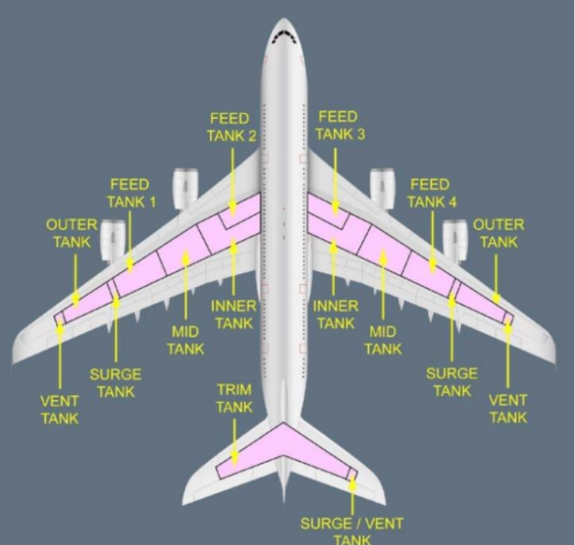
Aircraft Fuel Leaks Detection
The Fuel System:
The ultimate goal of any fuel system is to deliver the correct amount of fuel at the correct pressure to the engines at any time.
In our case, most part of the fuel system is located in the aircraft wings.

Slide 7
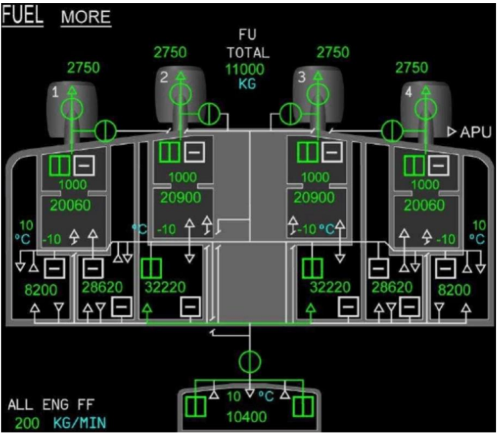
Aircraft Fuel Leaks Detection
The Fuel System:
Moving the fuel around the aircraft between the different tanks is what makes the aircraft fuel system so complex.
In this aircraft, there are 11 main tanks used to store fuel, with 5 main tanks in each wing and one additional tank on the horizontal stabilizer at the rear. In addition to these tanks there are several surge tanks and vent tanks.

Slide 8
Aircraft Fuel Leaks Detection
The Dataset:
Data from 8 different aircraft (some in-service aircraft and some flight-test aircraft) including ≈500 flights
Format: Mostly time series data from sensors
Pre- treatment:
Cleaned spurious data and missing data samples.
Duplicated signals have been merged into a single variable.
All signals have been put into a common sampling rate.

Slide 9
Aircraft Fuel Leaks Detection
The Dataset: 111 variables covering the following:
A/C and flight data:
Time, day, month, year and UTC date/time.
MSN and Flight number.
Flight phase.
Altitude, pitch and roll.
Fuel/Engine system data:
Engine status (Running or not).
Fuel flow (to each engine)
Fuel used (by engines).
Fuel on board (“FOB”).
Fuel quantity per collector cell and surge tank volume.
Pump status (On/Off, normally/abnormally, immersed/not immersed).
Leak detection and leak flow.
Fuel transfer mode.

Slide 10
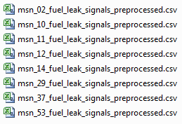
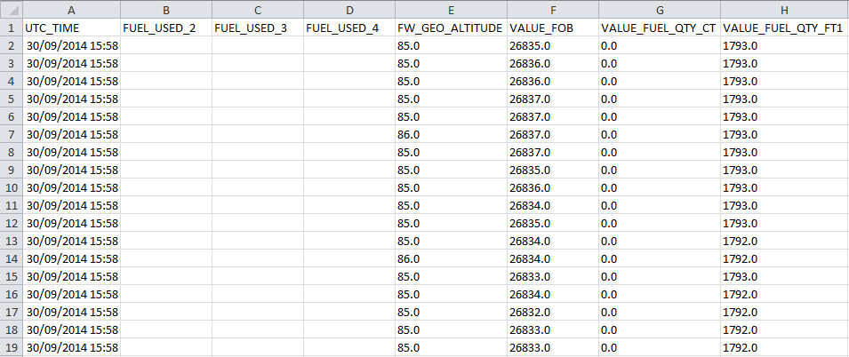
Aircraft Fuel Leaks Detection
The Dataset:
One csv file per aircraft: Example:

Slide 11
Aircraft Fuel Leaks Detection
Questions

Slide 12
Dataset Variables
SIGNAL NAME | SIGNAL NAME
UTC_TIME | STATE_PMP_XFR_2_L_IMMERSED
MSN | STATE_PMP_XFR_2_L_ON
Flight | STATE_PMP_XFR_3_R_ABNRM_ON
ENGINE_RUNNING_1 | STATE_PMP_XFR_3_R_IMMERSED
ENGINE_RUNNING_2 | STATE_PMP_XFR_3_R_ON
ENGINE_RUNNING_3 | STATE_PMP_XFR_4_R_ABNRM_ON
ENGINE_RUNNING_4 | STATE_PMP_XFR_4_R_IMMERSED
FLIGHT_PHASE_COUNT | STATE_PMP_XFR_4_R_LP
FUEL_FLOW_1 | STATE_PMP_XFR_4_R_ON
FUEL_FLOW_2 | STATUS_FUEL_LEAK_DETECTED_VALID
FUEL_FLOW_3 | TRANSFER_MODE
FUEL_FLOW_4 | VALUE_FOB
FUEL_PITCH | VALUE_FUEL_QTY_CC1
FUEL_ROLL | VALUE_FUEL_QTY_CC2
FUEL_TRANSFER_MODE_VALUE | VALUE_FUEL_QTY_CC3
FUEL_USED_1 | VALUE_FUEL_QTY_CC4
FUEL_USED_2 | VALUE_FUEL_QTY_CT
FUEL_USED_3 | VALUE_FUEL_QTY_FT1
FUEL_USED_4 | VALUE_FUEL_QTY_FT2
FW_GEO_ALTITUDE | VALUE_FUEL_QTY_FT3
LEAK_DETECTION_LEAK_FLOW | VALUE_FUEL_QTY_FT4
LSTU1_A_VOLUME | VALUE_FUEL_QTY_LXT
LSTU1_F_VOLUME | VALUE_FUEL_QTY_RXT

Slide 13
Dataset Variables
SIGNAL NAME | SIGNAL NAME
PITCH_ANGLE | day
ROLL_ANGLE | month
RSTU1_A_VOLUME | time
RSTU1_F_VOLUME | year
SELECTED_GADIR_ALTITUDE_VALUE | APU_FUEL_FLOW_REQUEST_SIGNAL_1
STATE_PMP_MAIN_FT1_ABNRM_ON | EF1_Density
STATE_PMP_MAIN_FT1_IMMERSED | EF4_Density
STATE_PMP_MAIN_FT1_ON | RESOLVED_STATE_V_D
STATE_PMP_MAIN_FT2_ABNRM_ON | RESOLVED_STATE_V_LP1
STATE_PMP_MAIN_FT2_IMMERSED | RESOLVED_STATE_V_LP2
STATE_PMP_MAIN_FT2_ON | RESOLVED_STATE_V_LP3
STATE_PMP_MAIN_FT3_ABNRM_ON | RESOLVED_STATE_V_LP4
STATE_PMP_MAIN_FT3_IMMERSED | RESOLVED_STATE_V_RM
STATE_PMP_MAIN_FT3_ON | RESOLVED_STATE_V_RP
STATE_PMP_MAIN_FT4_ABNRM_ON | RESOLVED_STATE_V_T1
STATE_PMP_MAIN_FT4_IMMERSED | RESOLVED_STATE_V_T2
STATE_PMP_MAIN_FT4_ON | RESOLVED_STATE_V_T3
STATE_PMP_STBY_FT1_ABNRM_ON | RESOLVED_STATE_V_T4
STATE_PMP_STBY_FT1_IMMERSED | RESOLVED_STATE_V_X1
STATE_PMP_STBY_FT1_ON | RESOLVED_STATE_V_X2
STATE_PMP_STBY_FT2_ABNRM_ON | RESOLVED_STATE_V_X3
STATE_PMP_XFR_2_L_ABNRM_ON

Slide 14
Dataset Variables
SIGNAL NAME | SIGNAL NAME
STATE_PMP_STBY_FT2_IMMERSED | RESOLVED_STATE_V_X4
STATE_PMP_STBY_FT2_ON | STATE_FUEL_QTY_ACCURACY_LST_DEGRADED
STATE_PMP_STBY_FT3_ABNRM_ON | STATE_FUEL_QTY_ACCURACY_RST_DEGRADED
STATE_PMP_STBY_FT3_IMMERSED | STATUS_FUEL_QTY_PART_UNUSABLE_LST
STATE_PMP_STBY_FT3_ON | STATUS_FUEL_QTY_PART_UNUSABLE_RST
STATE_PMP_STBY_FT4_ABNRM_ON | STATUS_FUEL_QTY_UNUSABLE_LST
STATE_PMP_STBY_FT4_IMMERSED | STATUS_FUEL_QTY_UNUSABLE_RST
STATE_PMP_STBY_FT4_ON | STATUS_OVERFLOW_LST
STATE_PMP_XFR_1_L_ABNRM_ON | STATUS_OVERFLOW_RST
STATE_PMP_XFR_1_L_IMMERSED | VALUE_FUEL_VOL_LST
STATE_PMP_XFR_1_L_ON | VALUE_FUEL_VOL_RST
STATE_PMP_XFR_2_L_ABNRM_ON

